Slide 1


Lab 11: Reinforcement Learning
With a focus on Homework 8
Harvard IACS
CS109B
Chris Tanner, Pavlos Protopapas, Mark Glickman

Slide 2

RL Environment
Agent
The thing that operates within the environment

Slide 3
RL Environment
Agent
States
The thing that operates within the environment
Static representations that define the current environment

Slide 4

RL Environment
Agent
States
Actions
The thing that operates within the environment
Static representations that define the current environment
An agent’s operation that takes him/her from state s to state s’

Slide 5

RL Environment
Agent
States
Actions
Reward
The thing that operates within the environment
Static representations that define the current environment
An agent’s operation that takes him/her from state s to state s’
A real-valued # that represents the goodness for the agent’s being in a given state s

Slide 6
The agent starts in an initial state s

Slide 7
The agent starts in an initial state s
She performs an action a and becomes in state s’

Slide 8
The agent starts in an initial state s
She performs an action a and becomes in state s’
Being in each state s’ yields a reward r (e.g, 3.6)

Slide 9
The agent starts in an initial state s
She performs an action a and becomes in state s’
Being in each state s’ yields a reward r (e.g, 3.6)
How do we determine how to move from state-to-state so as to receive maximum reward r?

Slide 10
The agent starts in an initial state s
She performs an action a and becomes in state s’
That’s the entire crux of reinforcement learning!
Being in each state s’ yields a reward r (e.g, 3.6)
How do we determine how to move from state-to-state so as to receive maximum reward r?

Slide 11
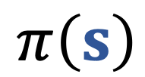
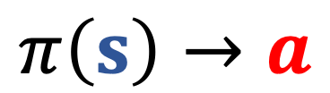
Given a state s, and an action a, estimate the reward r.
A policy takes a state s and executes an action a
$$π\left(s\right)$$
$$π\left(s\right)→a$$

Slide 12
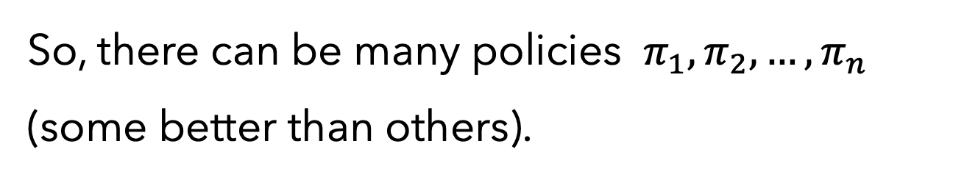
So, there can be many policies $π_{1},π_{2},…,π_{n}$ (some better than others).
which policy to execute?
How do we determine how to move from state-to-state so as to receive maximum reward r?
The one that gives us the highest reward! Let’s estimate each policy $π_{i}$ via a “value-function” $v_{π}\left(\text{s}\right)$, where s is our starting state

Slide 13
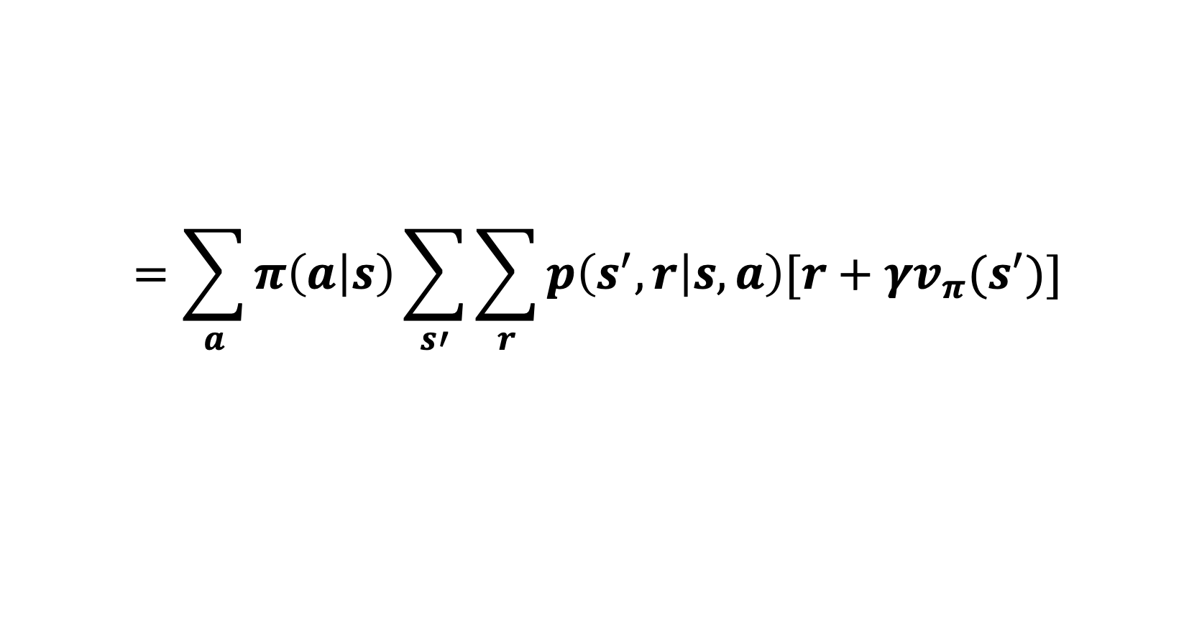
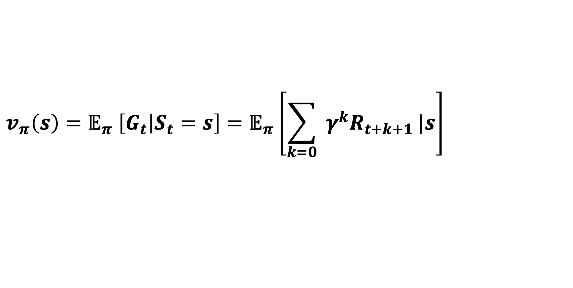
In class, we saw that:
$$v_{π}\left(s\right)=𝔼_{π} \left[G_{t} | S_{t}=s\right]=𝔼_{π}\left[\sum_{k=0}{ γ^{k}R_{t+k+1}}|s\right]$$
$$=\sum_{a}{π\left(a | s\right)\sum_{s′}{\sum_{r}{p\left(s^{′},r | s,a\right)[r+γv_{π}(s^{′})]}}}$$

Slide 14
In class, we saw that:
$$v_{π}\left(s\right)=𝔼_{π} \left[G_{t} | S_{t}=s\right]=𝔼_{π}\left[\sum_{k=0}{ γ^{k}R_{t+k+1}}|s\right]$$
The policy we’re interested in
$$=\sum_{a}{π\left(a | s\right)\sum_{s′}{\sum_{r}{p\left(s^{′},r | s,a\right)[r+γv_{π}(s^{′})]}}}$$

Slide 15
In class, we saw that:
Our starting state s
$$v_{π}\left(s\right)=𝔼_{π} \left[G_{t} | S_{t}=s\right]=𝔼_{π}\left[\sum_{k=0}{ γ^{k}R_{t+k+1}}|s\right]$$
The policy we’re interested in
$$=\sum_{a}{π\left(a | s\right)\sum_{s′}{\sum_{r}{p\left(s^{′},r | s,a\right)[r+γv_{π}(s^{′})]}}}$$

Slide 16
In class, we saw that:
Our starting state s
Cumulative reward
$$v_{π}\left(s\right)=𝔼_{π} \left[G_{t} | S_{t}=s\right]=𝔼_{π}\left[\sum_{k=0}{ γ^{k}R_{t+k+1}}|s\right]$$
The policy we’re interested in
$$=\sum_{a}{π\left(a | s\right)\sum_{s′}{\sum_{r}{p\left(s^{′},r | s,a\right)[r+γv_{π}(s^{′})]}}}$$

Slide 17
In class, we saw that:
Our starting state s
Cumulative reward
Unadjusted reward
$$v_{π}\left(s\right)=𝔼_{π} \left[G_{t} | S_{t}=s\right]=𝔼_{π}\left[\sum_{k=0}{ γ^{k}R_{t+k+1}}|s\right]$$
The policy we’re interested in
$$=\sum_{a}{π\left(a | s\right)\sum_{s′}{\sum_{r}{p\left(s^{′},r | s,a\right)[r+γv_{π}(s^{′})]}}}$$

Slide 18
In class, we saw that:
Weakened based on how far into the future it is
Our starting state s
Cumulative reward
Unadjusted reward
$$v_{π}\left(s\right)=𝔼_{π} \left[G_{t} | S_{t}=s\right]=𝔼_{π}\left[\sum_{k=0}{ γ^{k}R_{t+k+1}}|s\right]$$
The policy we’re interested in
$$=\sum_{a}{π\left(a | s\right)\sum_{s′}{\sum_{r}{p\left(s^{′},r | s,a\right)[r+γv_{π}(s^{′})]}}}$$

Slide 19
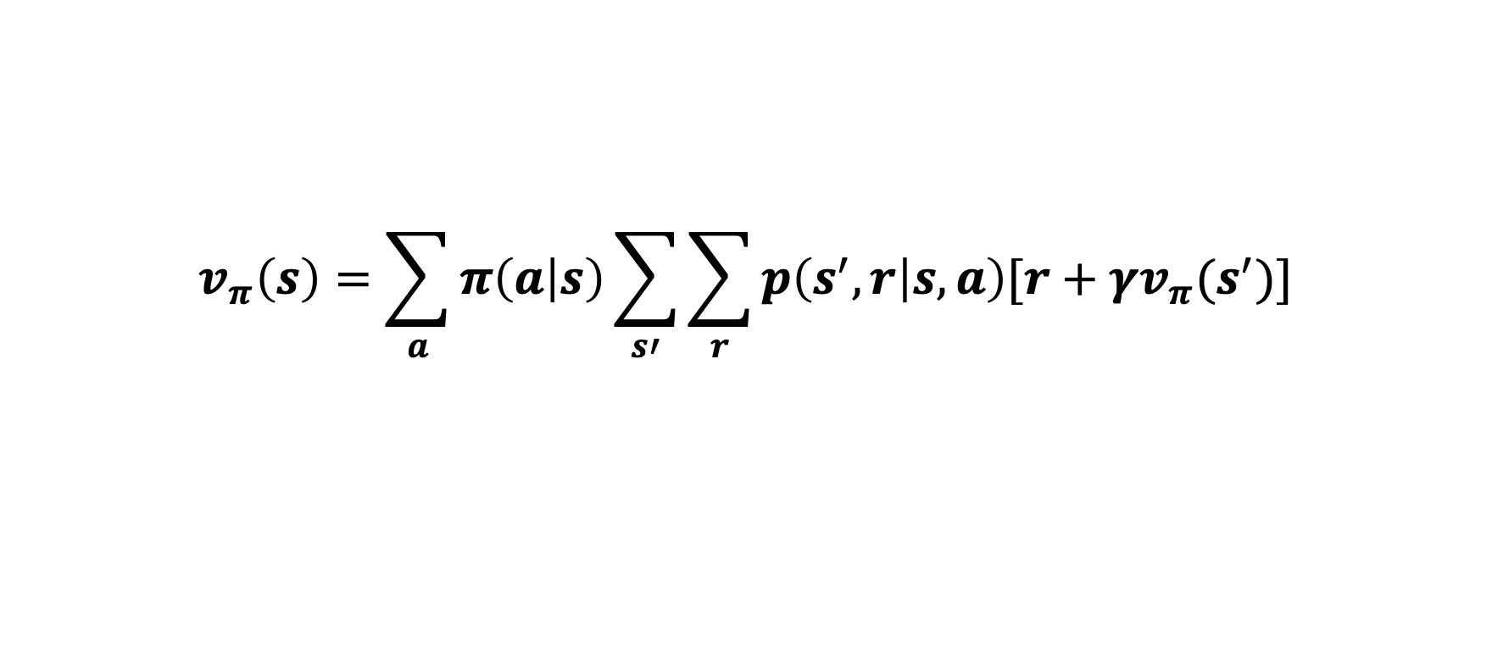
$$v_{π}\left(s\right)=\sum_{a}{π\left(a | s\right)\sum_{s′}{\sum_{r}{p\left(s^{′},r | s,a\right)[r+γv_{π}(s^{′})]}}}$$
HW #1.1
state-to-state transitions T
reward R
T=
R=

Slide 20
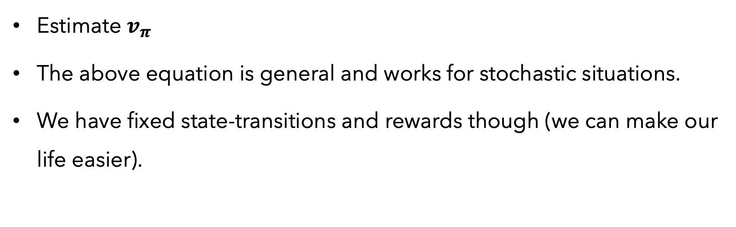
$$v_{π}\left(s\right)=\sum_{a}{π\left(a | s\right)\sum_{s′}{\sum_{r}{p\left(s^{′},r | s,a\right)[r+γv_{π}(s^{′})]}}}$$
HW #1.2
Estimate $v_{π}$
The above equation is general and works for stochastic situations.
We have fixed state-transitions and rewards though (we can make our life easier).

Slide 21
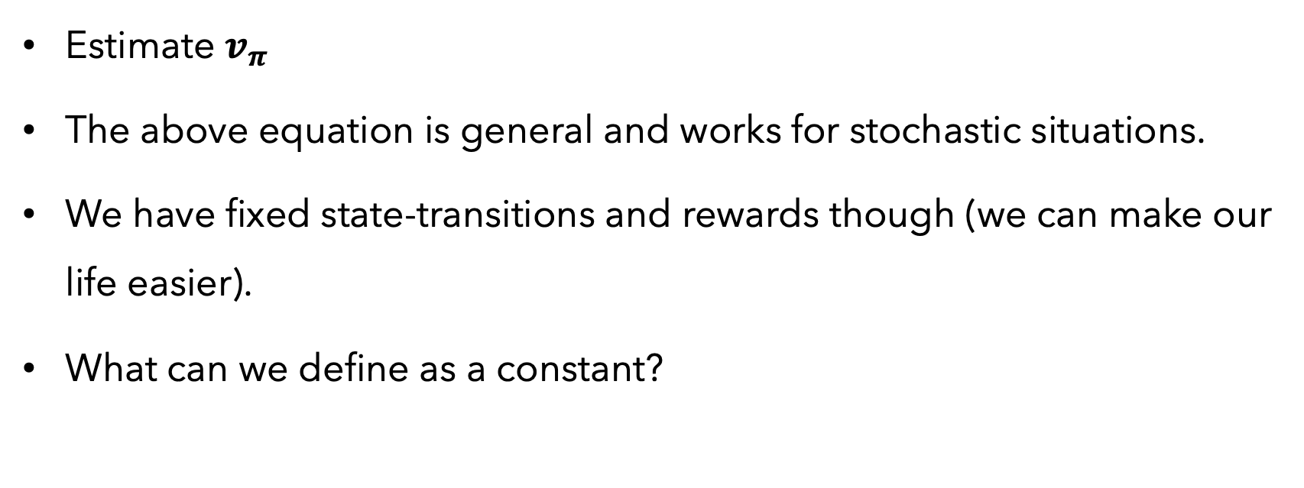
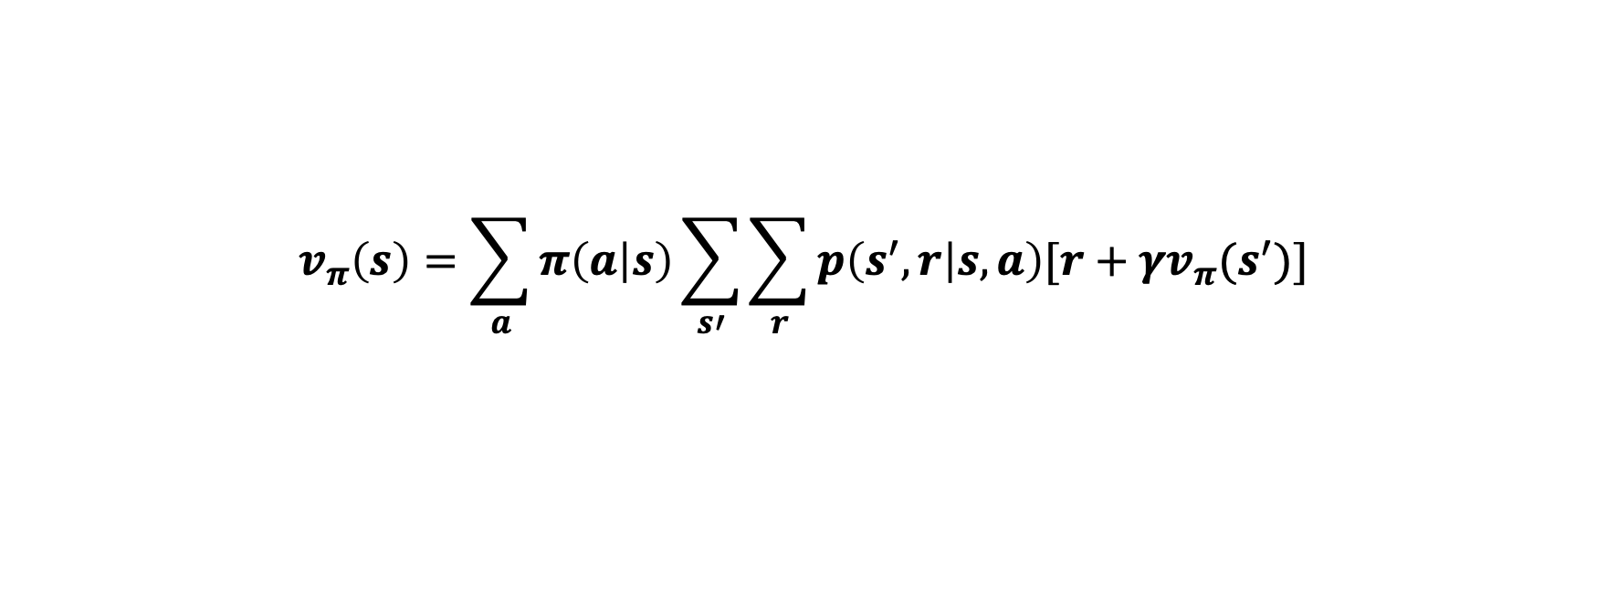
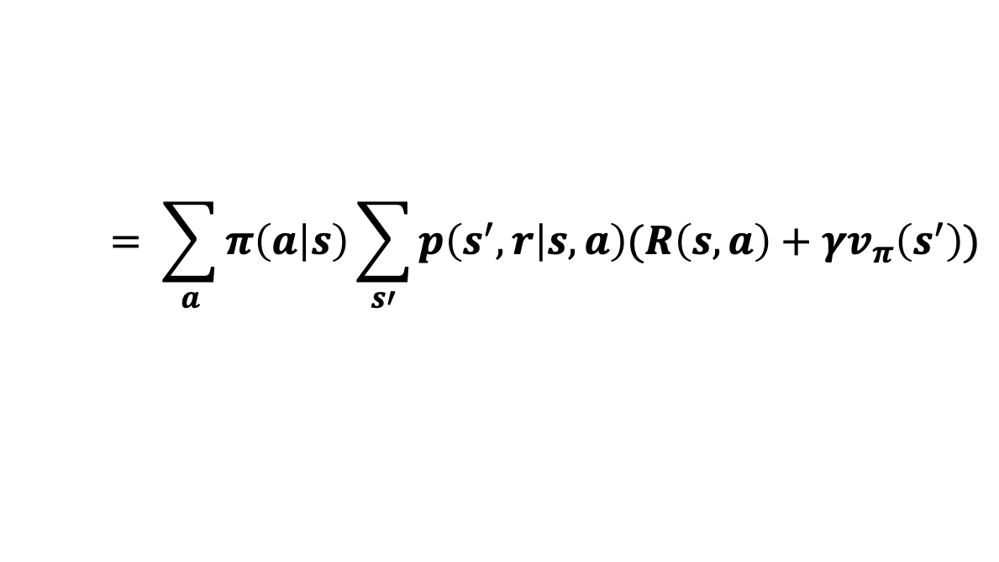
$$v_{π}\left(s\right)=\sum_{a}{π\left(a | s\right)\sum_{s′}{\sum_{r}{p\left(s^{′},r | s,a\right)[r+γv_{π}(s^{′})]}}}$$
$$= \sum_{a}{π\left(a | s\right)\sum_{s′}{p\left(s^{′},r | s,a\right)(R\left(s,a\right)+γv_{π}\left(s^{′}\right))}}$$
HW #1.2
Estimate $v_{π}$
The above equation is general and works for stochastic situations.
We have fixed state-transitions and rewards though (we can make our life easier).
What can we define as a constant?

Slide 22
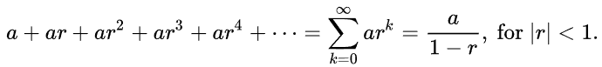
$$v_{π}\left(s\right)=\sum_{a}{π\left(a | s\right)\sum_{s′}{\sum_{r}{p\left(s^{′},r | s,a\right)[r+γv_{π}(s^{′})]}}}$$
$$= \sum_{a}{π\left(a | s\right)\sum_{s′}{p\left(s^{′},r | s,a\right)(R\left(s,a\right)+γv_{π}\left(s^{′}\right))}}$$
HW #1.2
As a sanity check, a geometric series is defined to have a sum:

Slide 23
Particularly, k-Means is generative, as it can be seen as a special case of Gaussian Mixture Models

Slide 24
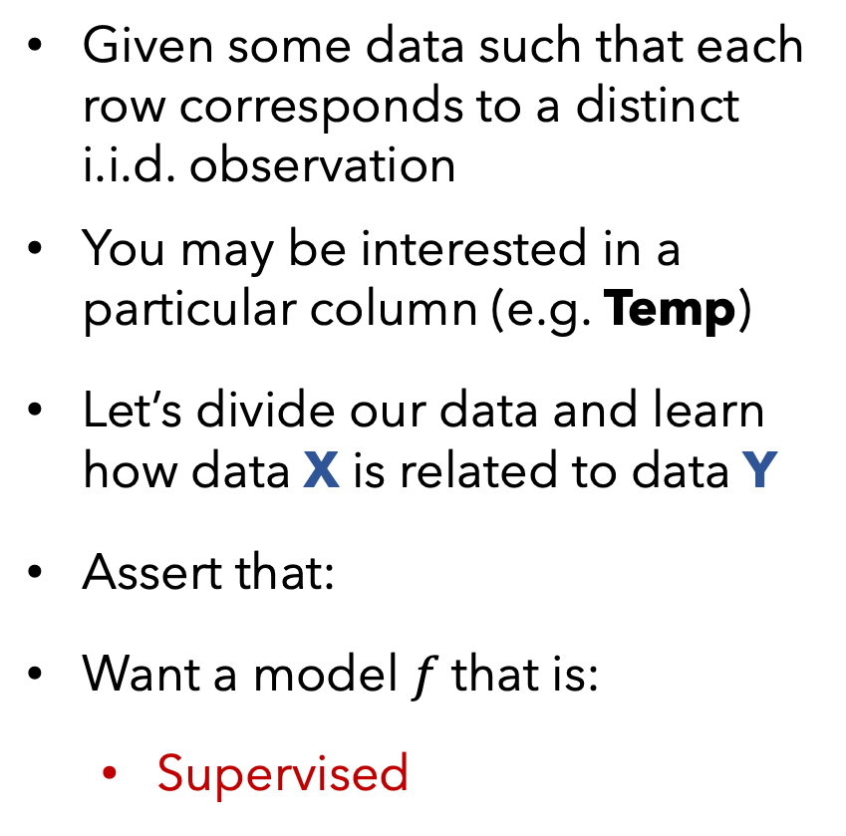
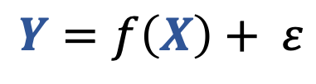
X
Y
Given some data such that each row corresponds to a distinct i.i.d. observation
You may be interested in a particular column (e.g. Temp)
Let’s divide our data and learn how data X is related to data Y
Assert that:
Want a model $f$that is:
Supervised
Age
Play
Rainy
Temp
22
29
31
23
37
41
29
21
30
N
Y
N
Y
N
Y
Y
N
Y
Y
N
N
N
Y
N
Y
N
N
91
89
56
71
72
83
97
64
68
$$Y=f\left(X\right)+ ε$$
Supervised

Slide 25
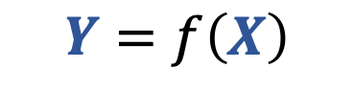
X
Y
Def:
Supervised models use target data, Y, to provide feedback so that your model can learn the relationship between X and Y.
Given some data such that each row corresponds to a distinct i.i.d. observation
You may be interested in a particular column (e.g. Temp)
Let’s divide our data and learn how data X is related to data Y
Assert that:
Want a model that is:
Supervised
Age
Play
Rainy
Temp
22
29
31
23
37
41
29
21
30
N
Y
N
Y
N
Y
Y
N
Y
Y
N
N
N
Y
N
Y
N
N
91
89
56
71
72
83
97
64
68
$$Y=f\left(X\right)+ ε$$
$$Y=f\left(X\right)$$
Supervised

Slide 26
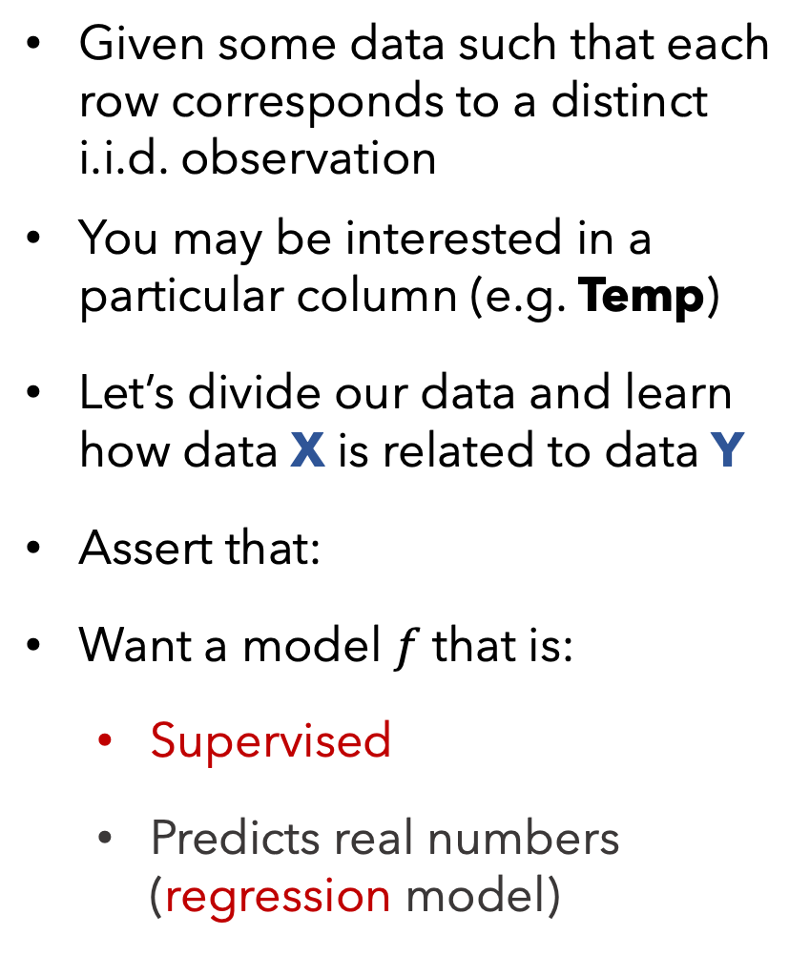
X
Y
Given some data such that each row corresponds to a distinct i.i.d. observation
You may be interested in a particular column (e.g. Temp)
Let’s divide our data and learn how data X is related to data Y
Assert that:
Want a model $f$that is:
Supervised
Predicts real numbers (regression model)
Age
Play
Rainy
Temp
22
29
31
23
37
41
29
21
30
N
Y
N
Y
N
Y
Y
N
Y
Y
N
N
N
Y
N
Y
N
N
91
89
56
71
72
83
97
64
68
$$Y=f\left(X\right)+ ε$$

Slide 27
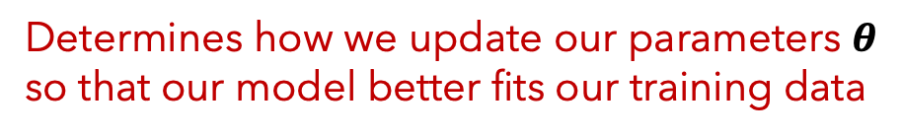
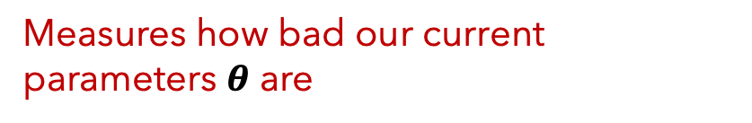
Supervised Models
IMPORTANT
When training any supervised model, be mindful of what you select for:
1. Our loss function (aka cost function)
Measures how bad our current parameters $θ$ are
2. Our optimization algorithm?
Determines how we update our parameters $θ$ so that our model better fits our training data

Slide 28
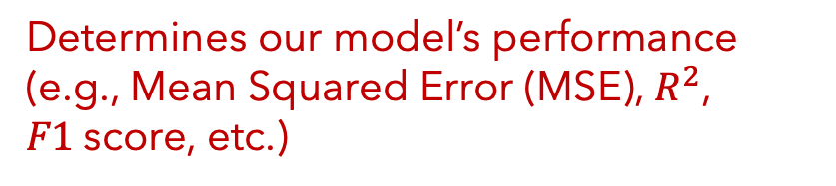
Supervised Models
IMPORTANT
When training any supervised model, be mindful of what you select for:
When testing our model’s predictions, be mindful of what you select for:
1. Our loss function (aka cost function)
3. Our evaluation metric
Measures how bad our current parameters $θ$ are
Determines our model’s performance (e.g., Mean Squared Error (MSE), $R^{2}$, $F1$score, etc.)
2. Our optimization algorithm?
Determines how we update our parameters $θ$ so that our model better fits our training data

Slide 29
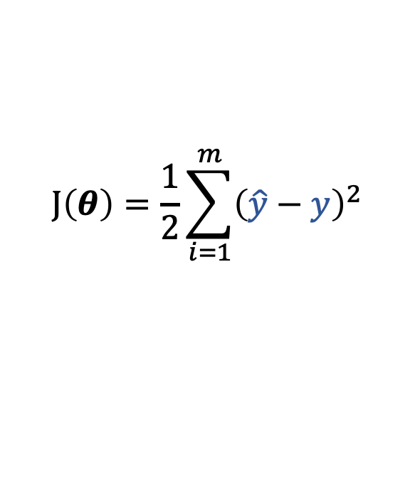

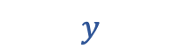
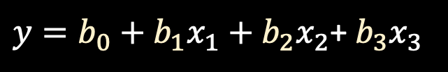
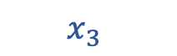
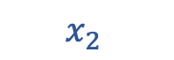
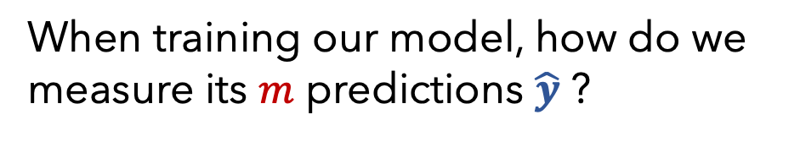
Linear Regression
Q1
When training our model, how do we measure its $m$ predictions $\hat{y}$ ?
91
$$y$$
$$J\left(θ\right)=\frac{1}{2}\sum_{i=1}^{m}{{\left(\hat{y}−y\right)}^{2}}$$
A1
Cost function
“Least Squares”
$y=b_{0}+b_{1}x_{1}+b_{2}x_{2}$+ $b_{3}x_{3}$
22
N
Y
$$x_{1}$$
$$x_{2}$$
$$x_{3}$$
Mathematically
Notes:
** ahead of time, we don’t know what the optimal theta parameters ought to be, we only know what the y values should be. So let’s just keep tweaking the parameters until we minimize the error of our predictions y-hat **

Slide 30
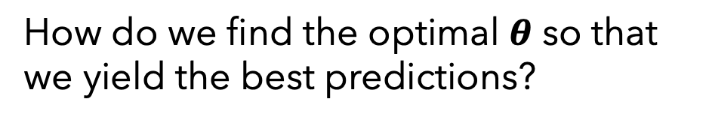
Linear Regression
Q1
When training our model, how do we measure its $m$ predictions $\hat{y}$ ?
91
$$y$$
$$J\left(θ\right)=\frac{1}{2}\sum_{i=1}^{m}{{\left(\hat{y}−y\right)}^{2}}$$
A1
Cost function
“Least Squares”
$y=b_{0}+b_{1}x_{1}+b_{2}x_{2}$+ $b_{3}x_{3}$
Q2
How do we find the optimal $θ$ so that we yield the best predictions?
22
N
Y
$$x_{1}$$
$$x_{2}$$
$$x_{3}$$
Mathematically

Slide 31
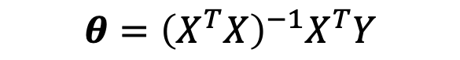
Linear Regression
Q1
When training our model, how do we measure its $m$ predictions $\hat{y}$ ?
91
$$y$$
$$J\left(θ\right)=\frac{1}{2}\sum_{i=1}^{m}{{\left(\hat{y}−y\right)}^{2}}$$
A1
Cost function
“Least Squares”
$y=b_{0}+b_{1}x_{1}+b_{2}x_{2}$+ $b_{3}x_{3}$
Q2
How do we find the optimal $θ$ so that we yield the best predictions?
A2
Two optimization algorithm options:
Gradient Descent (iteratively search)
Directly (closed-form solution)
22
N
Y
$$x_{1}$$
$$x_{2}$$
$$x_{3}$$
$$θ={\left(X^{T}X\right)}^{−1}X^{T}Y$$
Mathematically

Slide 32
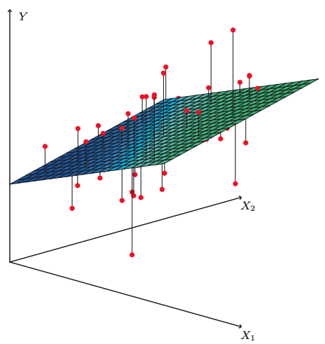
Linear Regression
Fitted model example
The plane is chosen to minimize the sum of the squared vertical distances (per our loss function, least squares) between each observation (red dots) and the plane.
Photo from ”An Introduction to Statistical Learning” (James, et al. 2017)

Slide 33
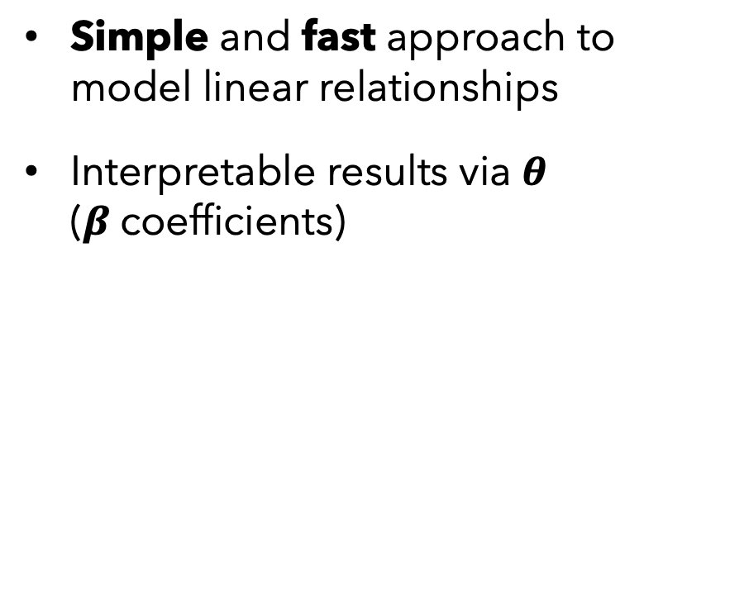
Linear Regression
PROS
CONS
Simple and fast approach to model linear relationships
Interpretable results via $θ$ ($β$coefficients)
Can’t model non-linear relationships
Vulnerable to outliers
Vulnerable to collinearity
Assumes error terms are uncorrelated*
* otherwise, we have false feedback during training

Slide 34
Supervised vs
Unsupervised
Regression vs Classification
Linear Regression
Supervised
Regression

Slide 35

X
Y
Returning to our data, let’s model Play instead of Temp
Again, we divide our data and learn how data X is related to data Y
Again, assert:
Age
Temp
Rainy
Play
22
29
31
23
37
41
29
21
30
91
89
56
71
72
83
97
64
68
Y
N
N
N
Y
N
Y
N
N
N
Y
N
Y
N
Y
Y
N
Y
$$Y=f\left(X\right)+ ε$$
Notes:
Y will represent our labelled data. Our gold truth.

Slide 36
X
Y
Returning to our data, let’s model Play instead of Temp
Again, we divide our data and learn how data X is related to data Y
Again, assert:
Want a model that is:
Supervised
Predicts categories/classes (classification model)
Q: What model could we use?
Age
Temp
Rainy
Play
22
29
31
23
37
41
29
21
30
91
89
56
71
72
83
97
64
68
Y
N
N
N
Y
N
Y
N
N
N
Y
N
Y
N
Y
Y
N
Y
$$Y=f\left(X\right)+ ε$$
Notes:
Y will represent our labelled data. Our gold truth.

Slide 37
?
Playground of Models
Age Temp Play
Linear
Regression

Slide 38
Playground of Models
Age Temp Play
Logistic
Regression
Linear
Regression

Slide 39
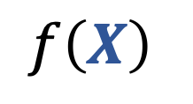
Logistic Regression
Y
$$f\left(X\right)$$
X
High-level
Notes:
TODO: ask questions about either the cost function, why we can’t use linear regression for categorical, how to find optimal theta
Think pair share will be on filling out the table after I introduce non-parametric.

Slide 40
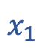
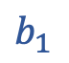

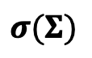
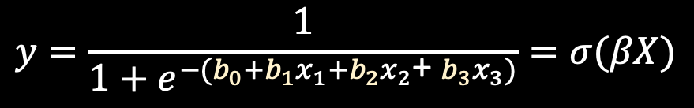
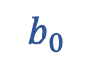
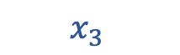
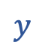
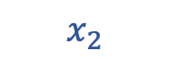
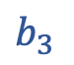
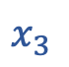

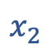
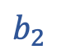
Logistic Regression
Y
N
$$y$$
$$y$$
$$σ(Σ)$$
$$f\left(X\right)$$
$$y=\frac{1}{1+e^{−(b_{0}+b_{1}x_{1}+b_{2}x_{2}\text{+} b_{3}x_{3})}}=σ(βX)$$
$$b_{0}$$
$$b_{1}$$
$$b_{2}$$
$$b_{3}$$
22
91
Y
$$x_{1}$$
$$x_{2}$$
$$x_{3}$$
X
$$x_{1}$$
$$x_{2}$$
$$x_{3}$$
Graphically (NN format)
High-level
Mathematically
Notes:
TODO: ask questions about either the cost function, why we can’t use linear regression for categorical, how to find optimal theta
Think pair share will be on filling out the table after I introduce non-parametric.

Slide 41
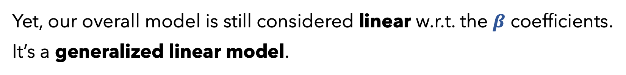
Logistic Regression
Y
This is a non-linear activation function, called a sigmoid.
N
$$y$$
Yet, our overall model is still considered linear w.r.t. the $β$ coefficients.
It’s a generalized linear model.
$$f\left(X\right)$$
$$y=\frac{1}{1+e^{−(b_{0}+b_{1}x_{1}+b_{2}x_{2}\text{+} b_{3}x_{3})}}=σ(βX)$$
22
91
Y
X
$$x_{1}$$
$$x_{2}$$
$$x_{3}$$
High-level
Mathematically
Notes:
TODO: ask questions about either the cost function, why we can’t use linear regression for categorical, how to find optimal theta
Think pair share will be on filling out the table after I introduce non-parametric.

Slide 42
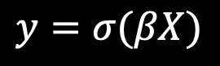
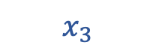
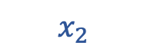


Logistic Regression
Q1
When training our model, how do we measure its $m$ predictions $\hat{y}$ ?
N
$$y$$
A1
Cost function
$$J\left(θ\right)=−[y\log{\hat{y}+}(1−y)\log{(1−\hat{y})]}$$
“Cross-Entropy” aka “Log loss”
$$y=σ(βX)$$
22
91
Y
$$x_{1}$$
$$x_{2}$$
$$x_{3}$$
Mathematically
Notes:
** we don’t have to use cross-entropy. We could use other ones, took, like Hinge loss or just create our own, but probably not advisable unless you have strong specifics as to what you want.
** liblinear because the model is still linear

Slide 43
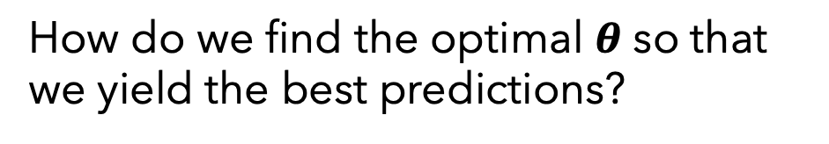
Logistic Regression
Q1
When training our model, how do we measure its $m$ predictions $\hat{y}$ ?
N
$$y$$
A1
Cost function
$$J\left(θ\right)=−[y\log{\hat{y}+}(1−y)\log{(1−\hat{y})]}$$
“Cross-Entropy” aka “Log loss”
$$y=σ(βX)$$
Q2
How do we find the optimal $θ$ so that we yield the best predictions?
22
91
Y
A2
Scikits has many optimization solvers:
(e.g., liblinear, newton-cg, saga, etc)
$$x_{1}$$
$$x_{2}$$
$$x_{3}$$
Mathematically
Notes:
** we don’t have to use cross-entropy. We could use other ones, took, like Hinge loss or just create our own, but probably not advisable unless you have strong specifics as to what you want.
** liblinear because the model is still linear

Slide 44
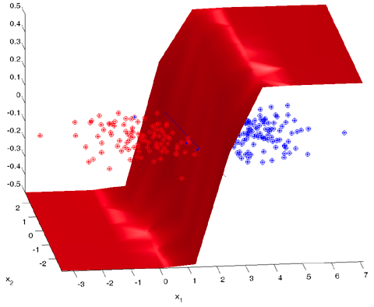
Logistic Regression
Fitted model example
The plane is chosen to minimize the error of our class probabilities (per our loss function, cross-entropy) and the true labels (mapped to 0 or 1)
Photo from http://strijov.com/sources/demoDataGen.php (Dr. Vadim Strijov)

Slide 45
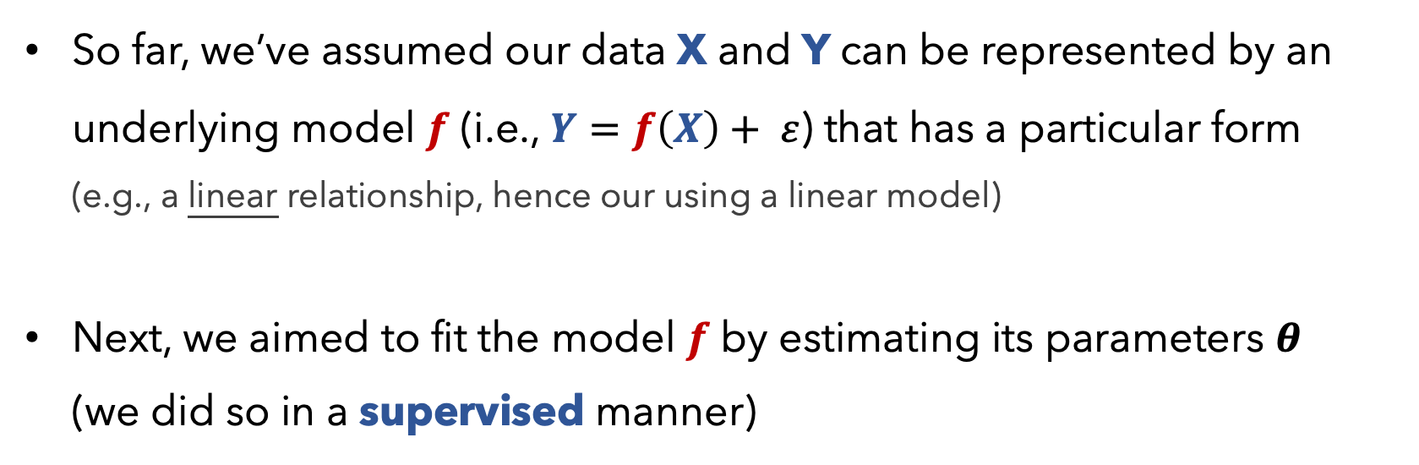
Parametric Models
So far, we’ve assumed our data X and Y can be represented by an underlying model $f$ (i.e., $Y=f\left(X\right)+ ε$) that has a particular form (e.g., a linear relationship, hence our using a linear model)
Next, we aimed to fit the model $f$ by estimating its parameters $θ$ (we did so in a supervised manner)

Slide 46
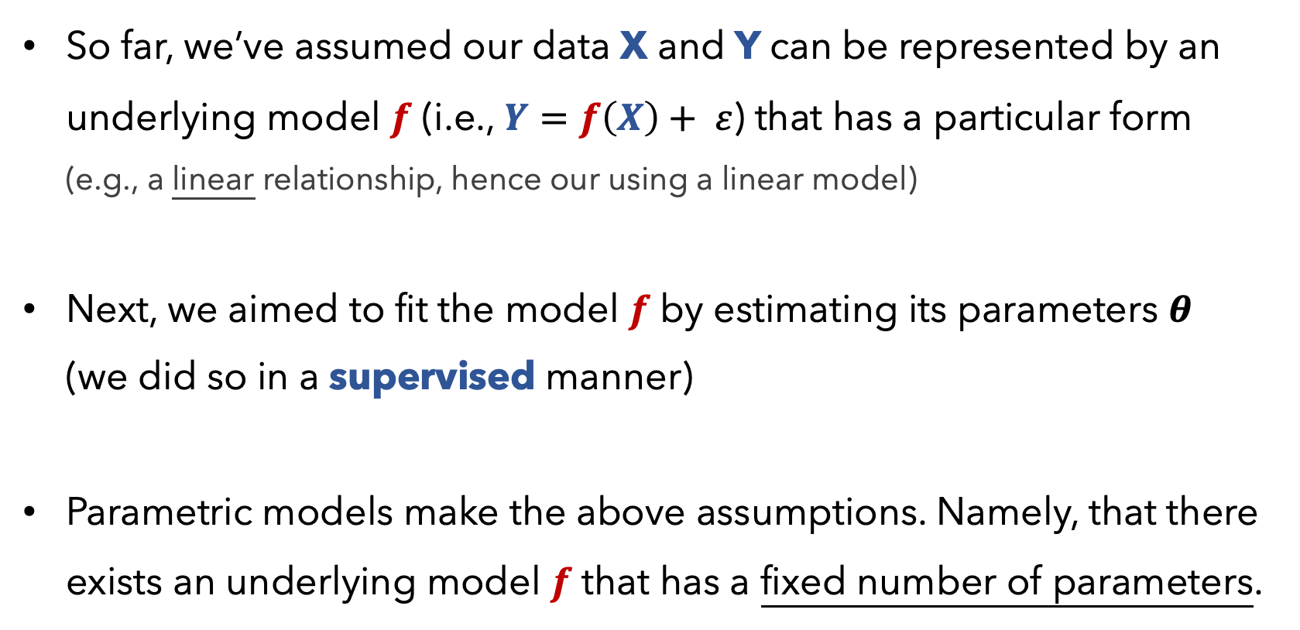
Parametric Models
So far, we’ve assumed our data X and Y can be represented by an underlying model $f$ (i.e., $Y=f\left(X\right)+ ε$) that has a particular form (e.g., a linear relationship, hence our using a linear model)
Next, we aimed to fit the model $f$ by estimating its parameters $θ$ (we did so in a supervised manner)
Parametric models make the above assumptions. Namely, that there exists an underlying model $f$ that has a fixed number of parameters.

Slide 47
Supervised vs
Unsupervised
Regression vs Classification
Parametric vs
Non-Parametric
Linear Regression
Logistic Regression
Supervised
Regression
Parametric
Supervised
Classification
Parametric

Slide 48
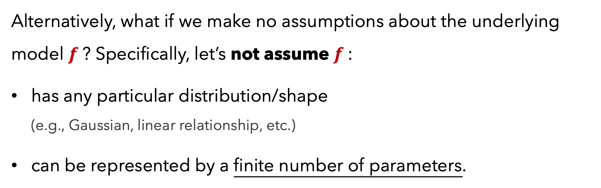
Non-Parametric Models
Alternatively, what if we make no assumptions about the underlying model $f$? Specifically, let’s not assume $f$:
has any particular distribution/shape (e.g., Gaussian, linear relationship, etc.)
can be represented by a finite number of parameters.

Slide 49
Non-Parametric Models
Alternatively, what if we make no assumptions about the underlying model $f$? Specifically, let’s not assume $f$:
has any particular distribution/shape (e.g., Gaussian, linear relationship, etc.)
can be represented by a finite number of parameters.
This would constitute a non-parametric model.

Slide 50
Non-Parametric Models
Non-parametric models are allowed to have parameters; in fact, oftentimes the # of parameters grows as our amount of training data increases
Since they make no strong assumptions about the form of the function/model, they are free to learn any functional form from the training data – infinitely complex.

Slide 51
X
Y
Returning to our data, let’s again predict if a person will Play
If we do not want to assume anything about how X and Y relate, we could use a different supervised model
Suppose we do not care to build a decision boundary but merely want to make predictions based on similar data that we saw during training
Age
Temp
Rainy
Play
22
29
31
23
37
41
29
21
30
91
89
56
71
72
83
97
64
68
Y
N
N
N
Y
N
Y
N
N
N
Y
N
Y
N
Y
Y
N
Y
Notes:
Y will represent our labelled data. Our gold truth.

Slide 52
?
Playground of Models
Age Temp Play
Logistic
Regression
Linear
Regression

Slide 53
Playground of Models
Age Temp Play
Logistic
Regression
Linear
Regression
k-NN
Notes:
*it’s our friendly *neighbor*

Slide 54






k-NN
Refresher:
k-NN doesn’t train a model
One merely specifies a $k$ value
At test time, a new piece of data $a$:
must be compared to all other training data $b$, to determine its k-nearest neighbors, per some distance metric $d\left(a,b\right)$
is classified as being the majority class (if categorical) or average (if quantitative) of its k-neighbors
N
$$y$$
$$y=σ(βX)$$
22
91
Y
$$x_{1}$$
$$x_{2}$$
$$x_{3}$$
Mathematically

Slide 55


k-NN
Conclusion:
k-NN makes no assumptions about the data $X$or the form of $f(X)$
k-NN is a non-parametric model

Slide 56
k-NN
PROS
CONS
Intuitive and simple approach
Can model any type of data / places no assumptions on the data
Fairly robust to missing data
Good for highly sparse data (e.g., user data, where the columns are thousands of potential items of interest)
Can be very computationally expensive if the data is large or high-dimensional
Should carefully think about features, including scaling them
Mixing quantitative and categorical data can be tricky
Interpretation isn’t meaningful
Often, regression models are better, especially with little data

Slide 57
Supervised vs
Unsupervised
Regression vs Classification
Parametric vs
Non-Parametric
Linear Regression
Logistic Regression
k-NN
Supervised
Regression
Parametric
Supervised
Classification
Parametric
Supervised
either
Non-Parametric

Slide 58
X
Y
Returning to our data yet again, let’s predict if a person will Play
If we do not want to assume anything about how X and Y relate, believing that no single equation can model the possibly non-linear relationship
Suppose we just want our model to have robust decision boundaries with interpretable results
Age
Temp
Rainy
Play
22
29
31
23
37
41
29
21
30
91
89
56
71
72
83
97
64
68
Y
N
N
N
Y
N
Y
N
N
N
Y
N
Y
N
Y
Y
N
Y

Slide 59
?
Playground of Models
Age Temp Play
Logistic
Regression
Linear
Regression
k-NN

Slide 60
Playground of Models
Age Temp Play
Logistic
Regression
Linear
Regression
Decision Tree
k-NN

Slide 61
Decision Tree
Refresher:
A Decision Tree iteratively determines how to split our data by the best feature value so as to minimize the entropy (uncertainty) of our resulting sets.
Must specify the:
Splitting criterion (e.g., Gini index, Information Gain)
Stopping criterion (e.g., tree depth, Information Gain Threshold)

Slide 62

Decision Tree
Refresher: Each comparison and branching represents splitting a region in the feature space on a single feature. Typically, at each iteration, we split once along one dimension (one predictor).

Slide 63
Supervised vs
Unsupervised
Regression vs Classification
Parametric vs
Non-Parametric
Linear Regression
Logistic Regression
k-NN
Decision Tree
Supervised
Regression
Parametric
Supervised
Classification
Parametric
Supervised
either
Non-Parametric
?
?
?

Slide 64
Decision Tree
A Decision Tree makes no distributional assumptions about the data.
The number of parameters / shape of the tree depends entirely on the data (i.e., imagine data that is perfectly separable into disjoint sections by features, vs data that is highly complex with overlapping values)
Decision Trees make use of the full data (X and Y) and can handle Y values that are categorical or quantitative

Slide 65
Supervised vs
Unsupervised
Regression vs Classification
Parametric vs
Non-Parametric
Linear Regression
Logistic Regression
k-NN
Decision Tree
Supervised
Regression
Parametric
Supervised
Classification
Parametric
Supervised
either
Non-Parametric
Supervised
either
Non-Parametric

Slide 66

Your Data X
Returning to our full dataset $X$, imagine we do not wish to leverage any particular column $Y$, but merely wish to transform the data into a smaller, useful representation $\acute{X}=f(X)$
Age
Play
Rainy
Temp
22
29
31
23
37
41
29
21
30
N
Y
N
Y
N
Y
Y
N
Y
Y
N
N
N
Y
N
Y
N
N
91
89
56
71
72
83
97
64
68

Slide 67
?
Playground of Models
Age Temp Play
Logistic
Regression
Linear
Regression
Decision Tree
k-NN

Slide 68
Playground of Models
PCA
Age Temp Play
Logistic
Regression
Linear
Regression
Decision Tree
k-NN

Slide 69
Principal Component Analysis (PCA)
Refresher:
PCA isn’t a model per se but is a procedure/technique to transform data, which may have correlated features, into a new, smaller set of uncorrelated features
These new features, by design, are a linear combination of the original features so as to capture the most variance
Often useful to perform PCA on data before using models that explicitly use data values and distances between them (e.g., clustering)

Slide 70
Supervised vs
Unsupervised
Regression vs Classification
Parametric vs
Non-Parametric
Linear Regression
Logistic Regression
k-NN
Decision Tree
PCA
Supervised
Regression
Parametric
Supervised
Classification
Parametric
Supervised
either
Non-Parametric
Supervised
either
Non-Parametric
Unsupervised
neither
Non-Parametric

Slide 71

Your Data X
Returning to our full dataset $X$ yet again, imagine we do not wish to leverage any particular column $Y$, but merely wish to discern patterns/groups of similar observations
Age
Play
Rainy
Temp
22
29
31
23
37
41
29
21
30
N
Y
N
Y
N
Y
Y
N
Y
Y
N
N
N
Y
N
Y
N
N
91
89
56
71
72
83
97
64
68

Slide 72
?
Playground of Models
PCA
Age Temp Play
Logistic
Regression
Linear
Regression
Decision Tree
k-NN

Slide 73
Playground of Models
Clustering
PCA
Age Temp Play
Logistic
Regression
Linear
Regression
Decision Tree
k-NN

Slide 74
Clustering
Refresher:
There are many approaches to clustering (e.g., k-Means, hierarchical, DBScan)
Regardless of the approach, we need to specify a distance metric (e.g., Euclidean, Manhattan)
Performance: we can measure the intra-cluster and outer-cluster fit (i.e., silhouette score), along with an estimate that compares our clustering to the situation had our data been randomly generated (gap statistic)

Slide 75


Clustering
k-Means example:
Although we are not explicitly using any column $Y$, one could imagine that the 3 resulting cluster labels are our $Y$’s (labels being class 1, 2, and 3)
Of course, we do not know these class labels ahead of time, as clustering is an unsupervised model
Visual Representation

Slide 76

Clustering
k-Means example:
Although we are not explicitly using any column $Y$, one could imagine that the 3 resulting cluster labels are our $Y$’s (labels being class 1, 2, and 3)
Of course, we do not know these class labels ahead of time, as clustering is an unsupervised model
Yet, one could imagine a narrative whereby our data points were generated by these 3 classes.
Visual Representation

Slide 77

Clustering
k-Means example:
That is, we are flipping the modelling process on its head; instead of doing our traditional supervised modelling approach of trying to estimate $P\left(Y | X\right):$
Imagine centroids for each of the 3 clusters $Y_{i}$. We assert that the data $X$were generated from $Y.$
We can estimate the joint probability of $P(Y,X)$
1
3
2
Visual Representation

Slide 78


Clustering
k-Means example:
That is, we are flipping the modelling process on its head; instead of doing our traditional supervised modelling approach of trying to estimate $P(Y|X)$
Imagine centroids for each of the 3 clusters $Y_{i}$. We assert that the data $X$were generated from $Y.$
We can estimate the joint probability of $P(Y,X)$
Assuming our data was generated from Gaussians centered at 3 centroids, we can estimate the probability of the current situation – that the data $X$exists and has the following class labels $Y$. This is a generative model.
1
3
2
Visual Representation

Slide 79
Clustering
k-Means example:
That is, we are flipping the modelling process on its head; instead of doing our traditional supervised modelling approach of trying to estimate $P(Y|X)$
Imagine centroids for each of the 3 clusters $Y_{i}$. We assert that the data $X$were generated from $Y.$
We can estimate the joint probability of $P(Y,X)$
1
Generative models explicitly model the actual distribution of each class (e.g., data and its cluster assignments).
3
2
Visual Representation

Slide 80
Clustering
k-Means example:
That is, we are flipping the modelling process on its head; instead of doing our traditional supervised modelling approach of trying to estimate $P\left(Y | X\right):$
Imagine centroids for each of the 3 clusters $Y_{i}$. We assert that the data $X$were generated from $Y.$
We can estimate the joint probability of $P(Y,X)$
1
3
2
Visual Representation

Slide 81


Clustering
k-Means example:
That is, we are flipping the modelling process on its head; instead of doing our traditional supervised modelling approach of trying to estimate $P(Y|X)$:
Imagine centroids for each of the 3 clusters $Y_{i}$. We assert that the data $X$were generated from $Y.$
We can estimate the joint probability of $P(Y,X)$
1
Supervised models are given some data $X$ and want to calculate the probability of $Y$.
They learn to discriminate between different values of possible $Y$’s (learns a decision boundary).
3
2
Visual Representation

Slide 82


Generative vs Discriminative Models
To recap:
By definition, a generative model is concerned with estimating the joint probability of $P(Y,X)$
By definition, a discriminative model is concerned with estimating the conditional probability $P(Y|X)$

Slide 83
Supervised vs
Unsupervised
Regression vs Classification
Parametric vs
Non-Parametric
Generative vs Discriminative
Linear Regression
Logistic Regression
k-NN
Decision Tree
PCA
Clustering
Supervised
Regression
Parametric
Discriminative
Supervised
Classification
Parametric
Discriminative
Supervised
either
Non-Parametric
Discriminative
Supervised
either
Non-Parametric
Discriminative
Unsupervised
neither
Non-Parametric
neither
Unsupervised
neither
Non-Parametric
Generative

Slide 84
Supervised vs
Unsupervised
Regression vs Classification
Parametric vs
Non-Parametric
Generative vs Discriminative
Linear Regression
Logistic Regression
k-NN
Decision Tree
PCA
Clustering
Supervised
Regression
Parametric
Discriminative
Supervised
Classification
Parametric
Discriminative
Supervised
either
Non-Parametric
Discriminative
Particularly, k-Means is generative, as it can be seen as a special case of Gaussian Mixture Models
Supervised
either
Non-Parametric
Discriminative
Unsupervised
neither
Non-Parametric
neither
Unsupervised
neither
Non-Parametric
Generative

Slide 85

Supervised vs
Unsupervised
Regression vs Classification
Parametric vs
Non-Parametric
Generative vs Discriminative
Linear Regression
Logistic Regression
k-NN
Decision Tree
PCA
Clustering
Supervised
Regression
Parametric
Discriminative
Given training $X$, learns to discriminate between possible $Y$ values (quantitative)
Supervised
Classification
Parametric
Discriminative
Supervised
either
Non-Parametric
Discriminative
Supervised
either
Non-Parametric
Discriminative
Unsupervised
neither
Non-Parametric
neither
Unsupervised
neither
Non-Parametric
Generative

Slide 86

Supervised vs
Unsupervised
Regression vs Classification
Parametric vs
Non-Parametric
Generative vs Discriminative
Linear Regression
Logistic Regression
k-NN
Decision Tree
PCA
Clustering
Supervised
Regression
Parametric
Discriminative
Supervised
Classification
Parametric
Discriminative
Given training $X$, learns to discriminate between possible $Y$ classes (categorical)
Supervised
either
Non-Parametric
Discriminative
Supervised
either
Non-Parametric
Discriminative
Unsupervised
neither
Non-Parametric
neither
Unsupervised
neither
Non-Parametric
Generative

Slide 87

Supervised vs
Unsupervised
Regression vs Classification
Parametric vs
Non-Parametric
Generative vs Discriminative
Linear Regression
Logistic Regression
k-NN
Decision Tree
PCA
Clustering
Supervised
Regression
Parametric
Discriminative
Supervised
Classification
Parametric
Discriminative
Supervised
either
Non-Parametric
Discriminative
Given training $X$, learns to discriminate between possible $Y$ values (quantitative or categorical)
Supervised
either
Non-Parametric
Discriminative
Unsupervised
neither
Non-Parametric
neither
Unsupervised
neither
Non-Parametric
Generative

Slide 88

Supervised vs
Unsupervised
Regression vs Classification
Parametric vs
Non-Parametric
Generative vs Discriminative
Linear Regression
Logistic Regression
k-NN
Decision Tree
PCA
Clustering
Supervised
Regression
Parametric
Discriminative
Supervised
Classification
Parametric
Discriminative
Supervised
either
Non-Parametric
Discriminative
Given training $X$, learns decision boundaries so as to discriminate between possible $Y$ values (quantitative or categorical)
Non-Parametric
Supervised
either
Discriminative
Unsupervised
neither
Non-Parametric
neither
Unsupervised
neither
Non-Parametric
Generative

Slide 89
Supervised vs
Unsupervised
Regression vs Classification
Parametric vs
Non-Parametric
Generative vs Discriminative
Linear Regression
Logistic Regression
k-NN
Decision Tree
PCA
Clustering
Supervised
Regression
Parametric
Discriminative
Supervised
Classification
Parametric
Discriminative
Supervised
either
Non-Parametric
Discriminative
Supervised
either
Non-Parametric
Discriminative
Unsupervised
neither
Non-Parametric
neither
PCA is a process, not a model, so it doesn’t make sense to consider it as a Discriminate or Generative model
Unsupervised
neither
Non-Parametric
Generative

Slide 90
Supervised vs
Unsupervised
Regression vs Classification
Parametric vs
Non-Parametric
Generative vs Discriminative
Linear Regression
Logistic Regression
k-NN
Decision Tree
PCA
Clustering
Supervised
Regression
Parametric
Discriminative
Supervised
Classification
Parametric
Discriminative
Supervised
either
Non-Parametric
Discriminative
Supervised
either
Non-Parametric
Discriminative
Unsupervised
neither
Non-Parametric
neither
Unsupervised
neither
Non-Parametric
Generative

Slide 91

X
Y
Returning our data yet again, perhaps we’ve plotted our data X and see it’s non-linear
Knowing how unnatural and finnicky polynomial regression can be, we prefer to let our model learn how to make its own non-linear functions for each feature $x_{i}$
Age
Play
Rainy
Temp
22
29
31
23
37
41
29
21
30
N
Y
N
Y
N
Y
Y
N
Y
Y
N
N
N
Y
N
Y
N
N
91
89
56
71
72
83
97
64
68
Notes:
Y will represent our labelled data. Our gold truth.

Slide 92
?
Playground of Models
Clustering
PCA
Age Temp Play
Logistic
Regression
Linear
Regression
Decision Tree
k-NN

Slide 93
Playground of Models
Clustering
PCA
GAMs
Age Temp Play
Logistic
Regression
Linear
Regression
Decision Tree
k-NN

Slide 94

Generalized Additive Models (GAMs)
Refresher:
Not our data, but imagine it’s plotting age vs temp:

Slide 95

Generalized Additive Models (GAMs)
Refresher:
We can make the line smoother by using a cubic spline or “B-spline”
Imagine having 3 of these models:
$f_{1}\left(age\right)$
$f_{2},\left(play\right)$
$f_{3}\left(rainy\right)$
Not our data, but imagine it’s plotting age vs Temp:
We can model Temp as:
$$\text{Temp}=β_{0}+f_{1}\left(age\right)+f_{2}\left(play\right)+f_{3}\left(rainy\right)$$

Slide 96










Generalized Additive Models (GAMs)
Y
91
$$y$$
$$Σ$$
$$y$$
$$β_{0}$$
$$1$$
$$1$$
$$1$$
$$f\left(X\right)$$
$$f_{1}$$
$$f_{2}$$
$$f_{3}$$
$$y=β_{0}+f_{1}\left(age\right)+f_{2}\left(play\right)+f_{3}\left(rainy\right)$$
$$1$$
$$1$$
$$1$$
22
N
Y
$$x_{1}$$
$$x_{2}$$
$$x_{3}$$
X
$$x_{1}$$
$$x_{2}$$
$$x_{3}$$
Graphically (NN format)
High-level
Mathematically

Slide 97

Generalized Additive Models (GAMs)
Y
It is called an additive model because we calculate a separate $f_{i}$ for each $x_{i}$ , and then add together all of their contributions.
91
$$y$$
$$Σ$$
$$y$$
$$β_{0}$$
$$1$$
$$1$$
$$1$$
$$f\left(X\right)$$
$$f_{1}$$
$$f_{2}$$
$$f_{3}$$
$$y=β_{0}+f_{1}\left(age\right)+f_{2}\left(play\right)+f_{3}\left(rainy\right)$$
$$1$$
$$1$$
$$1$$
22
N
Y
$$x_{1}$$
$$x_{2}$$
$$x_{3}$$
X
$$x_{1}$$
$$x_{2}$$
$$x_{3}$$
Graphically (NN format)
High-level
Mathematically

Slide 98
Generalized Additive Models (GAMs)
Y
It is called an additive model because we calculate a separate $f_{i}$ for each $x_{i}$ , and then add together all of their contributions.
91
$$y$$
$$Σ$$
$$y$$
$$β_{0}$$
$$1$$
$$1$$
$$1$$
$$f\left(X\right)$$
$$f_{1}$$
$$f_{2}$$
$$f_{3}$$
$$y=β_{0}+f_{1}\left(age\right)+f_{2}\left(play\right)+f_{3}\left(rainy\right)$$
$$1$$
$$1$$
$$1$$
$f_{i}$ doesn’t have to be a spline; can be any regression model
22
N
Y
$$x_{1}$$
$$x_{2}$$
$$x_{3}$$
X
$$x_{1}$$
$$x_{2}$$
$$x_{3}$$
Graphically (NN format)
High-level
Mathematically

Slide 99


Generalized Additive Models (GAMs)
PROS
CONS
Fits a non-linear function $f_{i}$ to each feature $x_{i}$
Much easier than guessing polynomial terms and multinomial interaction terms.
Model is additive, allowing us to exam the effects of each $x_{i}$on $y$ by holding the other features $x_{j≠i}$constant
The smoothness is easy to adjust
Restricted to being additive; important interactions may not be captured
Providing interactions via $f_{1}\left(age, rainy\right)$ can only capture so much, a la multinomial interaction terms

Slide 100
Supervised vs
Unsupervised
Regression vs Classification
Parametric vs
Non-Parametric
Generative vs Discriminative
Linear Regression
Logistic Regression
k-NN
Decision Tree
PCA
Clustering
GAMs
Supervised
Regression
Parametric
Discriminative
Supervised
Classification
Parametric
Discriminative
Supervised
either
Non-Parametric
Discriminative
Supervised
either
Non-Parametric
Discriminative
Unsupervised
neither
Non-Parametric
neither
Unsupervised
neither
Non-Parametric
Generative
Supervised
either
Parametric
Discriminative

Slide 101
X
Y
Returning our data yet again, perhaps we’ve plotted our data X and see it’s non-linear
We further suspect that there are complex interactions that cannot be represented by polynomial regression and GAMs
We just want great results and don’t care about interpretability
Age
Temp
Rainy
Play
22
29
31
23
37
41
29
21
30
91
89
56
71
72
83
97
64
68
Y
N
N
N
Y
N
Y
N
N
N
Y
N
Y
N
Y
Y
N
Y
Notes:
Y will represent our labelled data. Our gold truth.

Slide 102
?
Playground of Models
Clustering
PCA
GAMs
Age Temp Play
Logistic
Regression
Linear
Regression
Decision Tree
k-NN

Slide 103
Playground of Models
Feed-Forward Neural Net
Clustering
PCA
GAMs
Age Temp Play
Logistic
Regression
Linear
Regression
Decision Tree
k-NN

Slide 104






Feed-Forward Neural Network
Y
N
$$y$$
$$y=\frac{1}{1+e^{−(b_{0}+b_{1}h_{1}+b_{2}h_{2})}}=σ(β^{2}H)$$
$$f\left(X\right)$$
$$h_{i}=\frac{1}{1+e^{−(b_{0}+b_{1}x_{1}+b_{2}x_{2}\text{+} b_{3}x_{3})}}=σ(β^{1}X)$$
X
22
N
Y
$$x_{1}$$
$$x_{2}$$
$$x_{3}$$
High-level
Mathematically

Slide 105

Feed-Forward Neural Network
Y
N
$$y$$
$$y=\frac{1}{1+e^{−(b_{0}+b_{1}h_{1}+b_{2}h_{2})}}=σ(β^{2}H)$$
$$f\left(X\right)$$
$$h_{i}=\frac{1}{1+e^{−(b_{0}+b_{1}x_{1}+b_{2}x_{2}\text{+} b_{3}x_{3})}}=σ(β^{1}X)$$
NOTE: a Neural Network can be viewed as a function $f\left(X\right)$, just like all of our past models
X
22
N
Y
$$x_{1}$$
$$x_{2}$$
$$x_{3}$$
High-level
Mathematically

Slide 106

















Feed-Forward Neural Network
General Notes:
It’s a fully connected network
Every
Every
Parameters $θ=\{β, O\}$ (weights)
$$y$$
$$σ(Σ)$$
$$o_{1}^{1}$$
$$o_{2}^{1}$$
is a weight, which is multiplied by its input
$$h_{1}$$
$$σ(Σ)$$
$$h_{2}$$
$$σ(Σ)$$
is a scalar value
$$b_{1}^{1}$$
$$b_{2}^{2}$$
$$b_{3}^{2}$$
$$b_{1}^{2}$$
$$b_{3}^{1}$$
$$b_{2}^{1}$$
$$x_{1}$$
$$x_{2}$$
$$x_{3}$$
Graphically (NN format)

Slide 107

Feed-Forward Neural Network
General Notes:
It’s a fully connected network
Every
Every
Parameters $θ=\{β, O\}$ (weights)
$$y$$
$$σ(Σ)$$
$$o_{1}^{1}$$
$$o_{2}^{1}$$
is a weight, which is multiplied by its input
$$h_{1}$$
$$σ(Σ)$$
$$h_{2}$$
$$σ(Σ)$$
is a scalar value
$$b_{1}^{1}$$
$$b_{2}^{2}$$
$$b_{3}^{2}$$
$$b_{1}^{2}$$
$$b_{3}^{1}$$
$$b_{2}^{1}$$
Input layer
$$x_{1}$$
$$x_{2}$$
$$x_{3}$$
Graphically (NN format)

Slide 108
Feed-Forward Neural Network
General Notes:
It’s a fully connected network
Every
Every
Parameters $θ=\{β, O\}$ (weights)
$$y$$
$$σ(Σ)$$
$$o_{1}^{1}$$
$$o_{2}^{1}$$
is a weight, which is multiplied by its input
?
$$h_{1}$$
$$σ(Σ)$$
$$h_{2}$$
$$σ(Σ)$$
is a scalar value
$$b_{1}^{1}$$
$$b_{2}^{2}$$
$$b_{3}^{2}$$
$$b_{1}^{2}$$
$$b_{3}^{1}$$
$$b_{2}^{1}$$
$$x_{1}$$
$$x_{2}$$
$$x_{3}$$
Graphically (NN format)

Slide 109
Feed-Forward Neural Network
General Notes:
It’s a fully connected network
Every
Every
Parameters $θ=\{β, O\}$ (weights)
$$y$$
$$σ(Σ)$$
$$o_{1}^{1}$$
$$o_{2}^{1}$$
is a weight, which is multiplied by its input
Hidden layer
$$h_{1}$$
$$σ(Σ)$$
$$h_{2}$$
$$σ(Σ)$$
is a scalar value
$$b_{1}^{1}$$
$$b_{2}^{2}$$
$$b_{3}^{2}$$
$$b_{1}^{2}$$
$$b_{3}^{1}$$
$$b_{2}^{1}$$
$$x_{1}$$
$$x_{2}$$
$$x_{3}$$
Graphically (NN format)

Slide 110
Feed-Forward Neural Network
General Notes:
It’s a fully connected network
Every
Every
Parameters $θ=\{β, O\}$ (weights)
Output layer
$$y$$
$$σ(Σ)$$
$$o_{1}^{1}$$
$$o_{2}^{1}$$
is a weight, which is multiplied by its input
$$h_{1}$$
$$σ(Σ)$$
$$h_{2}$$
$$σ(Σ)$$
is a scalar value
$$b_{1}^{1}$$
$$b_{2}^{2}$$
$$b_{3}^{2}$$
$$b_{1}^{2}$$
$$b_{3}^{1}$$
$$b_{2}^{1}$$
$$x_{1}$$
$$x_{2}$$
$$x_{3}$$
Graphically (NN format)

Slide 111
Feed-Forward Neural Network
General Notes:
It’s a fully connected network
Every
Every
Parameters $θ=\{β, O\}$ (weights)
$$y$$
$$σ(Σ)$$
$$o_{1}^{1}$$
$$o_{2}^{1}$$
is a weight, which is multiplied by its input
$$h_{1}$$
$$σ(Σ)$$
$$h_{2}$$
$$σ(Σ)$$
is a scalar value
$$b_{1}^{1}$$
$$b_{2}^{2}$$
$$b_{3}^{2}$$
$$b_{1}^{2}$$
$$b_{3}^{1}$$
$$b_{2}^{1}$$
$$x_{1}$$
$$x_{2}$$
$$x_{3}$$
Graphically (NN format)

Slide 112
Feed-Forward Neural Network
General Notes:
It’s a fully connected network
Every
Every
Parameters $θ=\{β, O\}$ (weights)
$$y$$
$$σ(Σ)$$
$$o_{1}^{1}$$
$$o_{2}^{1}$$
is a weight, which is multiplied by its input
Every
, except for
$$h_{1}$$
$$σ(Σ)$$
$$h_{2}$$
$$σ(Σ)$$
the input layer’s, is called an activation function.
They take input(s), apply some aggregate operation(s) -- often a non-linear transformation -- and yield a scalar value.
is a scalar value
$$b_{1}^{1}$$
$$b_{2}^{2}$$
$$b_{3}^{2}$$
$$b_{1}^{2}$$
$$b_{3}^{1}$$
$$b_{2}^{1}$$
$$x_{1}$$
$$x_{2}$$
$$x_{3}$$
Graphically (NN format)

Slide 113

Feed-Forward Neural Network
General Notes:
It’s a fully connected network
Every
Every
Parameters $θ=\{β, O\}$ (weights)
$$y$$
$$σ(Σ)$$
$$o_{1}^{1}$$
$$o_{2}^{1}$$
is a weight, which is multiplied by its input
Every
, except for
$$h_{1}$$
$$σ(Σ)$$
$$h_{2}$$
$$σ(Σ)$$
the input layer’s, is called an activation function.
The sigmoid function $σ$ is a common choice and is equivalent to performing logistic regression on its given inputs.
is a scalar value
$$b_{1}^{1}$$
$$b_{2}^{2}$$
$$b_{3}^{2}$$
$$b_{1}^{2}$$
$$b_{3}^{1}$$
$$b_{2}^{1}$$
$$x_{1}$$
$$x_{2}$$
$$x_{3}$$
Graphically (NN format)

Slide 114
Feed-Forward Neural Network
General Notes:
It’s a fully connected network
Every
Every
Parameters $θ=\{β, O\}$ (weights)
$$y$$
$$σ(Σ)$$
$$o_{1}^{1}$$
$$o_{2}^{1}$$
is a weight, which is multiplied by its input
Every
, except for
$$h_{1}$$
$$σ(Σ)$$
$$h_{2}$$
$$σ(Σ)$$
the input layer’s, is called an activation function.
Thus, neural nets can be viewed as being a fully-connected set of logistic regressions, oftentimes stacked (multiple hidden layers)
is a scalar value
$$b_{1}^{1}$$
$$b_{2}^{2}$$
$$b_{3}^{2}$$
$$b_{1}^{2}$$
$$b_{3}^{1}$$
$$b_{2}^{1}$$
$$x_{1}$$
$$x_{2}$$
$$x_{3}$$
Graphically (NN format)

Slide 115
Feed-Forward Neural Network
Training:
Q1
$$y$$
$$σ(Σ)$$
How do we train a neural network?
$$o_{1}^{1}$$
$$o_{2}^{1}$$
$$h_{1}$$
$$σ(Σ)$$
$$h_{2}$$
$$σ(Σ)$$
$$b_{1}^{1}$$
$$b_{2}^{2}$$
$$b_{3}^{2}$$
$$b_{1}^{2}$$
$$b_{3}^{1}$$
$$b_{2}^{1}$$
$$x_{1}$$
$$x_{2}$$
$$x_{3}$$
Graphically (NN format)

Slide 116
Feed-Forward Neural Network
Training:
Q1
$$y$$
$$σ(Σ)$$
How do we train a neural network?
$$o_{1}^{1}$$
$$o_{2}^{1}$$
A1
First, specify a cost function and an optimization algorithm, just like we did for our other supervised, parametric models
$$h_{1}$$
$$σ(Σ)$$
$$h_{2}$$
$$σ(Σ)$$
$$b_{1}^{1}$$
$$b_{2}^{2}$$
$$b_{3}^{2}$$
$$b_{1}^{2}$$
$$b_{3}^{1}$$
$$b_{2}^{1}$$
$$x_{1}$$
$$x_{2}$$
$$x_{3}$$
Graphically (NN format)

Slide 117

Feed-Forward Neural Network
Training:
$$y$$
$$σ(Σ)$$
Cost function
$$J\left(θ\right)=−[y\log{\hat{y}+}(1−y)\log{(1−\hat{y})]}$$
$$o_{1}^{1}$$
$$o_{2}^{1}$$
“Cross-Entropy” aka “Log loss”
$$h_{1}$$
$$σ(Σ)$$
$$h_{2}$$
$$σ(Σ)$$
Update the $θ$ via gradient descent
$$b_{1}^{1}$$
$$b_{2}^{2}$$
$$b_{3}^{2}$$
$$b_{1}^{2}$$
$$b_{3}^{1}$$
$$b_{2}^{1}$$
$$x_{1}$$
$$x_{2}$$
$$x_{3}$$
Graphically (NN format)

Slide 118


Feed-Forward Neural Network
Training:
$$y$$
$$σ(Σ)$$
Initialize $θ$with random values
Repeat until convergence:
Provide input $x_{i}$ to the network
Propagate the values through the network
Calculate the cost/loss
Calculate gradients via backpropagation
Update the weights (aka $θ$) via gradient descent
$$o_{1}^{1}$$
$$o_{2}^{1}$$
$$h_{1}$$
$$σ(Σ)$$
$$h_{2}$$
$$σ(Σ)$$
$$b_{1}^{1}$$
$$b_{2}^{2}$$
$$b_{3}^{2}$$
$$b_{1}^{2}$$
$$b_{3}^{1}$$
$$b_{2}^{1}$$
$$x_{1}$$
$$x_{2}$$
$$x_{3}$$
Graphically (NN format)

Slide 119




Feed-Forward Neural Network
Training:
$$y$$
$$σ(Σ)$$
Initialize $θ$with random values
Repeat until convergence:
Provide input $x_{i}$ to the network
Propagate the values through the network
Calculate the cost/loss via gradient descent
Update the weights (aka $θ$) via backpropagation
$$o_{1}^{1}$$
$$o_{2}^{1}$$
$$h_{1}$$
$$σ(Σ)$$
$$h_{2}$$
$$σ(Σ)$$
$$b_{1}^{1}$$
$$b_{2}^{2}$$
$$b_{3}^{2}$$
$$b_{1}^{2}$$
$$b_{3}^{1}$$
$$b_{2}^{1}$$
$$x_{1}$$
$$x_{2}$$
$$x_{3}$$
Graphically (NN format)

Slide 120








Feed-Forward Neural Network
Training:
$$y$$
$$σ(Σ)$$
Initialize $θ$with random values
Repeat until convergence:
Provide input $x_{i}$ to the network
Propagate the values through the network
Calculate the cost/loss via gradient descent
Update the weights (aka $θ$) via backpropagation
$$o_{1}^{1}$$
$$o_{2}^{1}$$
$$h_{1}$$
$$σ(Σ)$$
$$h_{2}$$
$$σ(Σ)$$
$$b_{1}^{1}$$
$$b_{2}^{2}$$
$$b_{3}^{2}$$
$$b_{1}^{2}$$
$$b_{3}^{1}$$
$$b_{2}^{1}$$
$$x_{1}$$
$$x_{2}$$
$$x_{3}$$
Graphically (NN format)

Slide 121
Feed-Forward Neural Network
Training:
$$y$$
$$σ(Σ)$$
Initialize $θ$with random values
Repeat until convergence:
Provide input $x_{i}$ to the network
Propagate the values through the network
Calculate the cost/loss via gradient descent
Update the weights (aka $θ$) via backpropagation
$$o_{1}^{1}$$
$$o_{2}^{1}$$
$$h_{1}$$
$$σ(Σ)$$
$$h_{2}$$
$$σ(Σ)$$
$$b_{1}^{1}$$
$$b_{2}^{2}$$
$$b_{3}^{2}$$
$$b_{1}^{2}$$
$$b_{3}^{1}$$
$$b_{2}^{1}$$
22
91
1
Graphically (NN format)

Slide 122
Feed-Forward Neural Network
Training:
$$y$$
$$σ(Σ)$$
Initialize $θ$with random values
Repeat until convergence:
Provide input $x_{i}$ to the network
Propagate the values through the network
Calculate the cost/loss via gradient descent
Update the weights (aka $θ$) via backpropagation
$$o_{1}^{1}$$
$$o_{2}^{1}$$
$$h_{1}$$
.6
$$h_{2}$$
.2
$$b_{1}^{1}$$
$$b_{2}^{2}$$
$$b_{3}^{2}$$
$$b_{1}^{2}$$
$$b_{3}^{1}$$
$$b_{2}^{1}$$
22
91
1
Graphically (NN format)

Slide 123
Feed-Forward Neural Network
Training:
$$y$$
0.4
Initialize $θ$with random values
Repeat until convergence:
Provide input $x_{i}$ to the network
Propagate the values through the network
Calculate the cost/loss via gradient descent
Update the weights (aka $θ$) via backpropagation
$$o_{1}^{1}$$
$$o_{2}^{1}$$
$$h_{1}$$
.6
$$h_{2}$$
.2
$$b_{1}^{1}$$
$$b_{2}^{2}$$
$$b_{3}^{2}$$
$$b_{1}^{2}$$
$$b_{3}^{1}$$
$$b_{2}^{1}$$
22
91
1
Graphically (NN format)

Slide 124
Feed-Forward Neural Network
Training:
$$J\left(θ\right)=−[y\log{\hat{y}+}(1−y)\log{(1−\hat{y})]}$$
$$y$$
0.4
Initialize $θ$with random values
Repeat until convergence:
Provide input $x_{i}$ to the network
Propagate the values through the network
Calculate the cost/loss
Calculate gradients via backpropagation
Update the weights (aka $θ$) via gradient descent
$$o_{1}^{1}$$
$$o_{2}^{1}$$
$$h_{1}$$
.6
$$h_{2}$$
.2
$$b_{1}^{1}$$
$$b_{2}^{2}$$
$$b_{3}^{2}$$
$$b_{1}^{2}$$
$$b_{3}^{1}$$
$$b_{2}^{1}$$
22
91
1
Graphically (NN format)

Slide 125
Feed-Forward Neural Network
Training:
$$J\left(θ\right)=−[0+ (1−0)\log{(1−0.4)]}$$
$$y$$
0.4
Initialize $θ$with random values
Repeat until convergence:
Provide input $x_{i}$ to the network
Propagate the values through the network
Calculate the cost/loss
Calculate gradients via backpropagation
Update the weights (aka $θ$) via gradient descent
$$o_{1}^{1}$$
$$o_{2}^{1}$$
$$h_{1}$$
.6
$$h_{2}$$
.2
$$b_{1}^{1}$$
$$b_{2}^{2}$$
$$b_{3}^{2}$$
$$b_{1}^{2}$$
$$b_{3}^{1}$$
$$b_{2}^{1}$$
22
91
1
Graphically (NN format)

Slide 126
Feed-Forward Neural Network
Training:
$$J\left(θ\right)=−[0+ (1−0)\log{(0.6)]}$$
$$y$$
0.4
Initialize $θ$with random values
Repeat until convergence:
Provide input $x_{i}$ to the network
Propagate the values through the network
Calculate the cost/loss
Calculate gradients via backpropagation
Update the weights (aka $θ$) via gradient descent
$$o_{1}^{1}$$
$$o_{2}^{1}$$
$$h_{1}$$
.6
$$h_{2}$$
.2
$$b_{1}^{1}$$
$$b_{2}^{2}$$
$$b_{3}^{2}$$
$$b_{1}^{2}$$
$$b_{3}^{1}$$
$$b_{2}^{1}$$
22
91
1
Graphically (NN format)

Slide 127
Feed-Forward Neural Network
Training:
$$J\left(θ\right)=−\log{(0.6)}$$
$$y$$
0.4
Initialize $θ$with random values
Repeat until convergence:
Provide input $x_{i}$ to the network
Propagate the values through the network
Calculate the cost/loss
Calculate gradients via backpropagation
Update the weights (aka $θ$) via gradient descent
$$o_{1}^{1}$$
$$o_{2}^{1}$$
$$h_{1}$$
.6
$$h_{2}$$
.2
$$b_{1}^{1}$$
$$b_{2}^{2}$$
$$b_{3}^{2}$$
$$b_{1}^{2}$$
$$b_{3}^{1}$$
$$b_{2}^{1}$$
22
91
1
Graphically (NN format)

Slide 128
Feed-Forward Neural Network
Training:
$$J\left(θ\right)=0.22$$
$$y$$
0.4
Initialize $θ$with random values
Repeat until convergence:
Provide input $x_{i}$ to the network
Propagate the values through the network
Calculate the cost/loss
Calculate gradients via backpropagation
Update the weights (aka $θ$) via gradient descent
$$o_{1}^{1}$$
$$o_{2}^{1}$$
$$h_{1}$$
.6
$$h_{2}$$
.2
$$b_{1}^{1}$$
$$b_{2}^{2}$$
$$b_{3}^{2}$$
$$b_{1}^{2}$$
$$b_{3}^{1}$$
$$b_{2}^{1}$$
22
91
1
Graphically (NN format)

Slide 129


Feed-Forward Neural Network
Training:
$$J\left(θ\right)=0.22$$
$$y$$
0.4
Initialize $θ$with random values
$$∇_{2}^{2}$$
$$∇_{1}^{2}$$
$$o_{2}^{1}$$
Repeat until convergence:
Provide input $x_{i}$ to the network
Propagate the values through the network
Calculate the cost/loss
Calculate gradients via backpropagation
Update the weights (aka $θ$) via gradient descent
$$o_{1}^{1}$$
$$h_{1}$$
.6
$$h_{2}$$
.2
$$b_{1}^{1}$$
$$b_{2}^{2}$$
$$b_{3}^{2}$$
$$b_{1}^{2}$$
$$b_{3}^{1}$$
$$b_{2}^{1}$$
22
91
1
Graphically (NN format)

Slide 130








Feed-Forward Neural Network
Training:
$$J\left(θ\right)=0.22$$
$$y$$
0.4
Initialize $θ$with random values
Repeat until convergence:
Provide input $x_{i}$ to the network
Propagate the values through the network
Calculate the cost/loss
Calculate gradients via backpropagation
Update the weights (aka $θ$) via gradient descent
$$∇_{1}^{2}$$
$$∇_{2}^{2}$$
$$h_{1}$$
.6
$$h_{2}$$
.2
$$∇_{1}^{1}$$
$$∇_{2}^{1}$$
$$∇_{3}^{2}$$
$$b_{1}^{1}$$
$$∇_{1}^{2}$$
$$∇_{2}^{2}$$
$$∇_{3}^{1}$$
$$b_{3}^{2}$$
$$b_{1}^{2}$$
$$b_{2}^{2}$$
$$b_{2}^{1}$$
$$b_{3}^{1}$$
22
91
1
Graphically (NN format)

Slide 131








Feed-Forward Neural Network
Training:
$$J\left(θ\right)=0.22$$
$$y$$
$$σ(Σ)$$
Initialize $θ$with random values
Repeat until convergence:
Provide input $x_{i}$ to the network
Propagate the values through the network
Calculate the cost/loss
Calculate gradients via backpropagation
Update the weights (aka $θ$) via gradient descent
$$o_{1}^{1}$$
$$o_{2}^{1}$$
$$h_{1}$$
$$σ(Σ)$$
$$h_{2}$$
$$σ(Σ)$$
$$b_{1}^{1}$$
$$b_{2}^{2}$$
$$b_{3}^{2}$$
$$b_{1}^{2}$$
$$b_{3}^{1}$$
$$b_{2}^{1}$$
22
91
1
Graphically (NN format)

Slide 132

Feed-Forward Neural Network
Training:
$$J\left(θ\right)=0.22$$
$$y$$
$$σ(Σ)$$
Initialize $θ$with random values
Repeat until convergence:
Provide input $x_{i}$ to the network
Propagate the values through the network
Calculate the cost/loss
Calculate gradients via backpropagation
Update the weights (aka $θ$) via gradient descent
$$o_{1}^{1}$$
$$o_{2}^{1}$$
$$h_{1}$$
$$σ(Σ)$$
$$h_{2}$$
$$σ(Σ)$$
$$b_{1}^{1}$$
$$b_{2}^{2}$$
$$b_{3}^{2}$$
$$b_{1}^{2}$$
$$b_{3}^{1}$$
$$b_{2}^{1}$$
22
91
1
Graphically (NN format)

Slide 133

Feed-Forward Neural Network
PROS
CONS
Fits many linear or non-linear activation functions $f_{i}$ to combinations of input $X$
Can model highly complex behavior
When designed well, can provide state-of-the-art results on most tasks
Incredible resources, libraries, and support
Sensitive to architecture choices and hyperparameters
Tricky to debug
Can be computationally expensive
Poor interpretability

Slide 134
Supervised vs
Unsupervised
Regression vs Classification
Parametric vs
Non-Parametric
Generative vs Discriminative
Linear Regression
Logistic Regression
k-NN
Decision Tree
PCA
Clustering
GAMs
Feed-Forward Net
Supervised
Regression
Parametric
Discriminative
Supervised
Classification
Parametric
Discriminative
Supervised
either
Non-Parametric
Discriminative
Supervised
either
Non-Parametric
Discriminative
Unsupervised
neither
Non-Parametric
neither
Unsupervised
neither
Non-Parametric
Generative
Supervised
either
Parametric
Discriminative
Supervised
either
Parametric
Discriminative

Slide 135


Supervised Models
IMPORTANT
When training any supervised model, be careful of overfitting your model
A good model should generalize well to unseen (i.e., testing) data
Consider adding regularization term $R\left(θ\right)$ to your cost function
Imposes a penalty based on your parameter values $θ$
L1 regularization:
$R\left(θ\right)$ = $\sum_{i=1}^{n}{|θ_{i}|}$
Prefers sparse weights (many 0’s)
L2 regularization:
$R\left(θ\right)$ = $\sum_{i=1}^{n}{θ_{i}^{2}}$
Prefers many small-weight values
Additionally, you can add dropout to Neural Networks

Slide 136
Supervised Models
IMPORTANT
When training any supervised model, wisely use your training data
A good model should generalize well to unseen (i.e., testing) data
Shuffle your training data and optionally bootstrap samples
Perform cross-validation

Slide 137



MLE vs MAP
So far, whenever we’ve discussed training a model, we’ve assumed our data was i.i.d. and we framed the problem as maximizing the similarity of the predictions and the gold truth by adjusting the parameters $θ$
e.g.
Q1
When training our model, how do we measure its $m$ predictions $\hat{y}$ ?
$$J\left(θ\right)=\frac{1}{2}\sum_{i=1}^{m}{{\left(\hat{y}−y\right)}^{2}}$$
A1
Cost function
“Least Squares”

Slide 138

MLE vs MAP
We were performing the maximum likelihood estimate
Def:
maximum likelihood estimate (MLE) asserts that we should choose $θ$ so as to maximize the probability of the observed data (i.e., our $\hat{y}$ should become as close to $y$ as possible)

Slide 139


MLE vs MAP
In other words, we were searching for ${\hat{θ}}_{MLE}$
Say we have the likelihood function $P(D|θ)$
$${\hat{θ}}_{MLE}={\text{argmax}}_{θ}P(D|θ)$$
Notes:
TODO: Update this!!!

Slide 140


MLE vs MAP
MAP stands for maximum a posteriori and is interested in calculating $P(θ|D)$
If we have knowledge about the prior distribution $P(θ)$, we can calculate:
$$P\left(θ | D\right)= \frac{P\left(D | θ\right)P\left(θ\right) }{P\left(X\right)}= ∝P\left(D | θ\right)P\left(θ\right)$$

Slide 141

MLE vs MAP
MAP stands for maximum a posteriori and is interested in calculating $P(θ|D)$
If we have knowledge about the prior distribution $P(θ)$, we can calculate:
$$P\left(θ | D\right)= \frac{P\left(D | θ\right)P\left(θ\right) }{P\left(X\right)}= ∝P\left(D | θ\right)P\left(θ\right)$$
$${\hat{θ}}_{MAP}={\text{argmax}}_{θ}P\left(D | θ\right)P\left(θ\right)$$

Slide 142

MLE vs MAP
MAP stands for maximum a posteriori and is interested in calculating $P(θ|D)$
If we have knowledge about the prior distribution $P(θ)$, we can calculate:
NOTE: If the prior $P\left(θ\right)$ is uniform (i.e., not Gaussian or any other distribution), then ${\hat{θ}}_{MAP}={\hat{θ}}_{MLE}$
$$P\left(θ | D\right)= \frac{P\left(D | θ\right)P\left(θ\right) }{P\left(X\right)}= ∝P\left(D | θ\right)P\left(θ\right)$$
Thus, MLE is a special case of MAP!
$${\hat{θ}}_{MAP}={\text{argmax}}_{θ}P\left(D | θ\right)P\left(θ\right)$$

Slide 143
CS109B: What’s next
We have a learned a lot so far, with the assumption that our data is “flat” (each feature/column is independent of the others)
But what if our data is different?

Slide 144

CS109B: What’s next
Scenario: imagine having picture data, whereby each pixel is a feature. Obviously, pixels near one another in 2D space (both vertically and horizontally) are highly correlated.
Detecting lung cancer
A flattened vector wouldn’t work well.

Slide 145
CS109B: What’s next
Solution: CNNs

Slide 146
CS109B: What’s next
We have a learned a lot so far, with the assumption that our data is i.i.d. (each row is independent from one another)
But what if our data is different?

Slide 147
CS109B: What’s next
Scenario: imagine having data that is sequential in nature (e.g., natural text, speech, video frames, time series data)
“Today, I went to the _____ “
UNDERESTANDING LANGUAGE
PREDICTING EARTHQUAKES

Slide 148
CS109B: What’s next
Solution: RNNs / LSTMs

Slide 149
CS109B: What’s next
We have learned that PCA can transform our data while maintaining variance. However, it’s unsupervised. Can we learn a better representation of our data?
Perhaps, we can learn how the data was “generated”?
Solution: Autoencoders

Slide 150
CS109B: What’s next
Can we generate realistic, synthetic data, and do so in such a realistic way that it increases the performance of our classifiers?
Solution: GANs (not GAMs)
DeepFake is an example that uses GANs

Slide 151
CS109B: What’s next
Instead of making just 1 prediction per preset input, sometimes we may want to get real-time feedback as to what our prediction’s effects were. For example, navigating through an environment or game (Mars or Chess Board)
We need to represent the updated environment, possible actions to take, risks of those actions, etc.
Solution: Reinforcement Learning

Slide 152
CS109B: What’s next
Questions?

